Slide 1
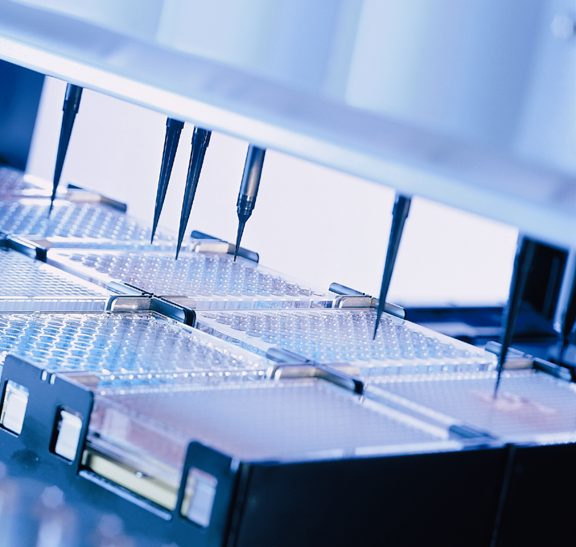

HAMILTON MICROLAB® STAR
Arrays in steps

Slide 2
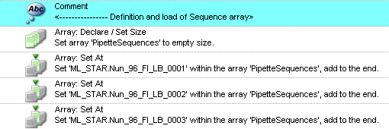
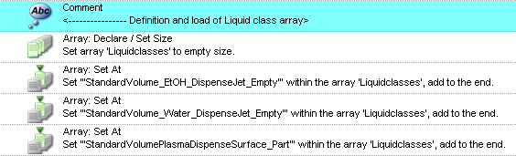
HAMILTON MICROLAB® STAR
Make sure that the array(s) you want to use are present and filled:

Slide 3
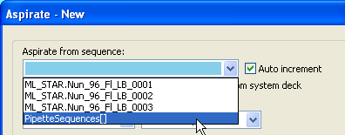
HAMILTON MICROLAB® STAR
Select the array in the pipetting (here: Aspirate) step

Slide 4

HAMILTON MICROLAB® STAR
Click on the array assistant

Slide 5
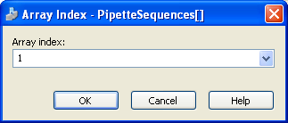
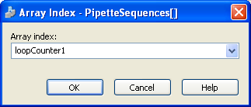
HAMILTON MICROLAB® STAR
Insert an index as integer…
…or a variable

Slide 6
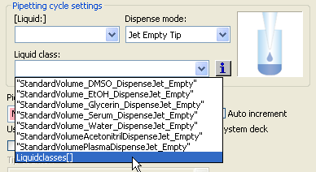
HAMILTON MICROLAB® STAR
For Liquid classes, only select the Array of Liq Classes
[Liquid:] and Dispense mode: are not used in this case

Slide 7


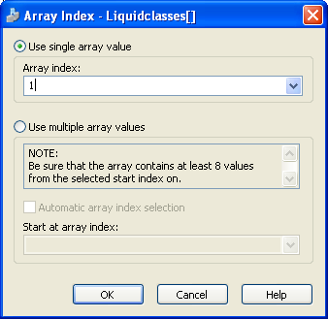
HAMILTON MICROLAB® STAR
Volume and liquid class arrays offer 2 ways for index:

Slide 8
HAMILTON MICROLAB® STAR
Volume and liquid class arrays offer two ways for index:
Single Array
Multiple Array

Slide 9

HAMILTON MICROLAB® STAR
Single Array
Possible entries:
A integer value (see above)
A variable name (new or existing)
Notes:
The index is one-based (array index 1 refers to the first array element)!
Be sure that the array always contains the required number of array
elements and that they are correctly initialized (see documentation of the
input field where the array is used). If the array index is for example set
to 50, the array must contain at least 50 valid elements!
It is not possible to use another array element as array index

Slide 10

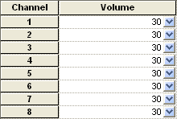
HAMILTON MICROLAB® STAR
Single Array
Volume array
Index | Value
1 | 20
2 | 30
3 | 40
Same value for all channels

Slide 11
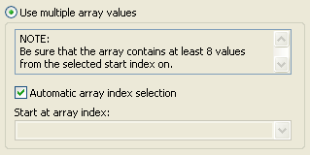
HAMILTON MICROLAB® STAR
Multiple Array I
Example:
A Smart Step processes some well defined positions and uses therefore
an array with all the volumes of the individual positions. In this case the
step needs only the array without index, because the index is for example
defined by the currently processed position.
Different value for each channel, starting at index 1

Slide 12
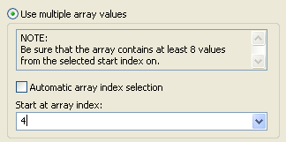
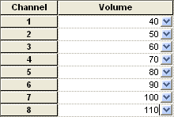
HAMILTON MICROLAB® STAR
Multiple Array II
Start at array index
Index | Value
1 | 10
2 | 20
3 | 30
4 | 40
5 | 50
6 | 60
7 | 70
8 | 80
9 | 90
10 | 100
11 | 110
12 | 120
Different value for each channel

Slide 13

HAMILTON MICROLAB® STAR
Multiple Array II
Start at array index
(This value depends on the number of installed channels)

Slide 14
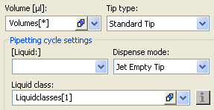
HAMILTON MICROLAB® STAR
Multiple Array II
Having an array of liquid classes, the Tip type will be taken from the array, not from the filter field Tip type

Slide 15
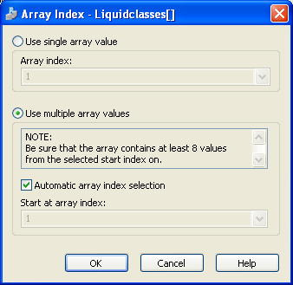
HAMILTON MICROLAB® STAR
Multiple Array II
This makes it possible to have different tip types in the same Asp/Disp cycle, each one using it‘s own liquid class

Slide 16
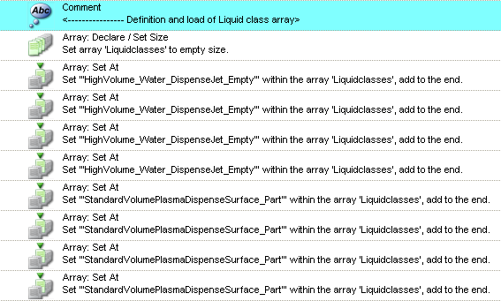
HAMILTON MICROLAB® STAR
Multiple Array II
Of course, the Tip Pickup must then be made in an appropiate way matching to the array
4x High Volume Liq. Class
4x Standard Volume Liq. Class

Slide 17
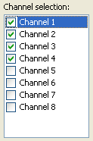
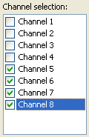
HAMILTON MICROLAB® STAR
Multiple Array II
4x High Volume Liq. Class
Tip pickup pattern
4x Standard Volume Liq. Class
Tip pickup pattern

